Slide 1


Scott Dinse PT, ATC
Director of Physical Therapy
UB South Campus

Slide 2
EMERGENCY ACTION PLAN
Scott Dinse, PT, ATC
Director of Rehab and Athletic Training
UBMD Orthopaedics and Sports Medicine
sadinse@buffalo.edu
716-628-0984

Slide 3
Why an EAP?
One of the first lines of defense for catastrophic injuries is having a comprehensive, detailed plan for most scenarios.
provide information to ensure response to an emergency is rapid, appropriate, controlled and precise.

Slide 4
Journal of Athletic Training 2002;37(1):99–104
© by the National Athletic Trainers’ Association, Inc www.journalofathletictraining.org
National Athletic Trainers’ Association Position Statement: Emergency Planning in Athletics
J. C. Andersen*; Ronald W. Courson†; Douglas M. Kleiner‡; Todd A. McLoda§
*Armstrong Atlantic State University, Savannah, GA; †University of Georgia, Athens, GA; ‡University of Florida, Health Science Center/Jacksonville, Jacksonville, FL; §Illinois State University, Normal, IL
J. C. Andersen, PhD, ATC, PT, SCS, contributed to conception and design; acquisition and analysis and interpretation of the data; and drafting, critical revision, and final approval of the article. Ronald W. Courson, ATC, PT, NREMT-I, CSCS, Douglas
M. Kleiner, PhD, ATC, CSCS, NREMT, FACSM, and Todd A. McLoda, PhD, ATC, contributed to acquisition and analysis and interpretation of the data and drafting, critical revision, and final approval of the article.
Address correspondence to National Athletic Trainers’ Association, Communications Department, 2952 Stemmons Freeway,
Dallas, TX 75247.

Slide 5
BENEFITS OF HAVING AN EMERGENCY ACTION PLAN
Risk management strategy: lead to prevention of athletic injury
Readily prepared for emergency situations
Ensures that appropriate care is provided in a timely manner
Decrease chance of legal action taking place
Protects liability of ATC and school administration
Leads to a more effective emergency response

Slide 6
Why do we need an emergency action plan
It helps us prepare for our season
It makes us all remember the young lives we are in charge of
It is SOP for athletics, legally without one we are liable
In an emergency anything that can go wrong will and we need a path to guide our actions.

Slide 7
Basics vs Details
We need both types of action plans
Planning in vague detail the who, when and where
Giving the basics to visiting teams and new volunteers.

Slide 8
Basic plan
Where are we, specific address and directions for EMS to fastest arrival at down athlete
How and who activates EMS
Where is the AED and who can get it fastest
Who is meeting EMS
Who is most experienced first responder to care for individual
Who is in charge of the venue( kids and those not involved in care removed)
Who is communicating with family or guardian

Slide 9
Emergency Action Plan
Venue: Williamsville North High School
Girls Basketball
March 1, 2023
Athletic Trainer:
Vanessa 716-###-####
Director of Athletics or Local Contact person: Julie Arnold
716-###-####
jarnold@williamsvillek12.org
Sectional Chairperson:
Chris Durr cdurr@williamsvillek12.org 716-###-####
Method for activating EMS:
ATC or person designated by ATC call 911 for local volunteer EMS
Access and Egress to Venue for EMS
Door 25, 26 off parking lot by tennis courts, lot off Hopkins
If parent or guardian is not present coach or school representative will travel with EMS. Location of closest AED
Hallway wall under the athletics TV monitor.
Lightening or severe weather shelter (where) Indoor event

Slide 10
Detailed Plan
Plan for everything……………………..then it hopefully never happens
Cardiac
Respiratory…. Asthma, Choking, Anaphylaxis
Diabetic
Orthopedic
Neurological
Heat illness
Weather

Slide 11
Korey Stringer Institute
https://ksi.uconn.edu/prevention/emergency-action-plans/
https://ksi.uconn.edu/prevention/emergency-action-plans/medical-time-out/
Korey Stringer fill in EAP template

Slide 12
One of the first lines of defense for catastrophic injuries is having a comprehensive, detailed plan for most catastrophic scenarios. This is commonly referred to as an Emergency Action Plan (EAP). The National Athletic Trainers Association has published a position statement titled “Emergency Planning in Athletics” that provides guidelines for the development and implementation of an EAP and is available online. This page summarizes the main points of this document.
An EAP is necessary for any school or university and all of the venues within these institutions where athletes exercise. The EAP provides information to ensure response to an emergency is rapid, appropriate, controlled and precise. All personnel involved with the organization of athletic activities share a professional and legal responsibility to ensure that guidelines are in place to manage any emergency that could arise. The EAP defines the standard of care for these situations, and therefore an institution without an EAP can be found to be negligent in cases of catastrophic injuries.
While being comprehensive, an EAP also needs to be flexible enough to be applicable to any emergency situation. While health care providers are usually responsible for the writing of this document, all those involved with athletic teams (athletic directors, team physicians, athletic trainers, athletic training students, coaches, strength and conditioning coaches, local EMS services) need to be aware and knowledgeable with its contents. It is best to also involve EMS in the writing of the EAP and have the medical director for the school/university approve its contents
BENEFITS OF HAVING AN EMERGENCY ACTION PLAN
Risk management strategy: lead to prevention of athletic injury
Readily prepared for emergency situations
Ensures that appropriate care is provided in a timely manner
Decrease chance of legal action taking place
Protects liability of ATC and school administration
Leads to a more effective emergency response
The EAP needs to be specific to each athletic venue and address the following components:
Emergency Personnel – Describe the emergency team involved when the EAP is activated and the roles of each person.
Emergency Communication – What communication devices are available, where, what number to call in an emergency, specific information and directions to the venue to provide to EMS response team.
Emergency Equipment – Location of equipment should be quickly accessible and clearly listed. Equipment needs to be maintained on a regular basis.
Medical Emergency Transportation – Describe options and estimated response times for emergency transportation.
Venue Directions with a Map – (should be specific to the venue, and provide instructions for easy access to venue)
Roles of First Responders – Establish scene safety and immediate care of the athlete, activation of EMS, equipment retreival, direction of EMS to the scene
Emergency Action Plan for Non-Medical Emergencies – These emergencies can refer to the school emergency action plan if one is in place

Slide 13
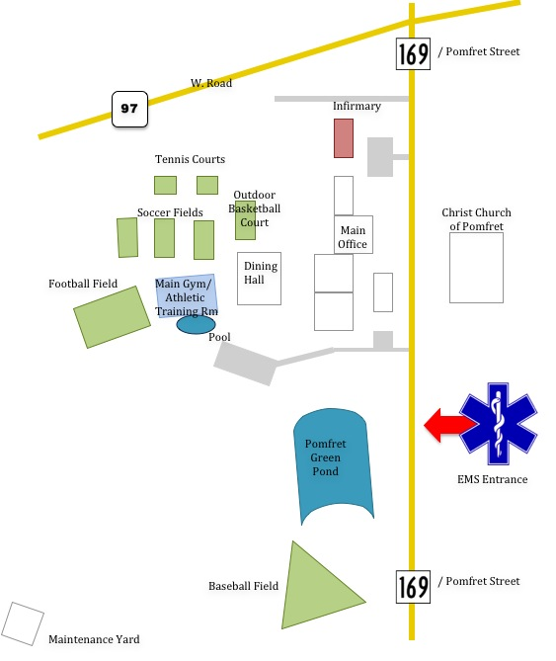

Slide 14
MEDICAL TIME OUT
While it is imperative to have an Emergency Action Plan, it is equally important that the EAP be practiced and understood by all involved. A medical timeout is designed to prepare athletic trainers, emergency medical services, team physicians and anyone designated as responsible for the medical well-being of athletes or spectators on game day to be aware, prepared and educated. Communication between these individuals can make the difference between a positive outcome and a negative experience should an injury or incident occur. Following a medical timeout procedure reduces, and in most cases, eliminates chaos and confusion because these professionals simply took the time to be prepared.
All great professionals know being prepared is vital to achieving success. Whether it’s in business, academics, medicine or sports, many of us run through at least a mental checklist before we engage in activity. It’s within that preparation that we find what is needed, how it should be implemented and what to do if everything we’ve planned for doesn’t come to fruition. Those who are truly prepared take the time to verbalize and record those thoughts in an effort to get others moving in a similar direction. Leaders strive to be proactive and take the time to prepare themselves, their staff and everyone around them to effectively respond in the best- and worst- case scenario.
The Medical Time Out (MTO), originally created by the Kyle Group and co-branded by the Korey Stringer Institute, provides a template for organizations to follow to prepare their medical timeout. The MTO includes the following:
Advanced Cardiovascular Life Support (ACLS)
AED pl
ement on the sidelines
Sentinel seizure/agonal respiration awareness procedures
Backboard
Face Mask Removal and tools
C-Spine injury protocol
Environmental risk status (e.g. heat, lightning, cold)
Cool prior to transport
Lightning plan
Hemorrhage control kit
It should also include contact information for the following:
Athletic Trainer(s)
Team Physician(s)
EMS Squad
Designated hospital

Slide 15
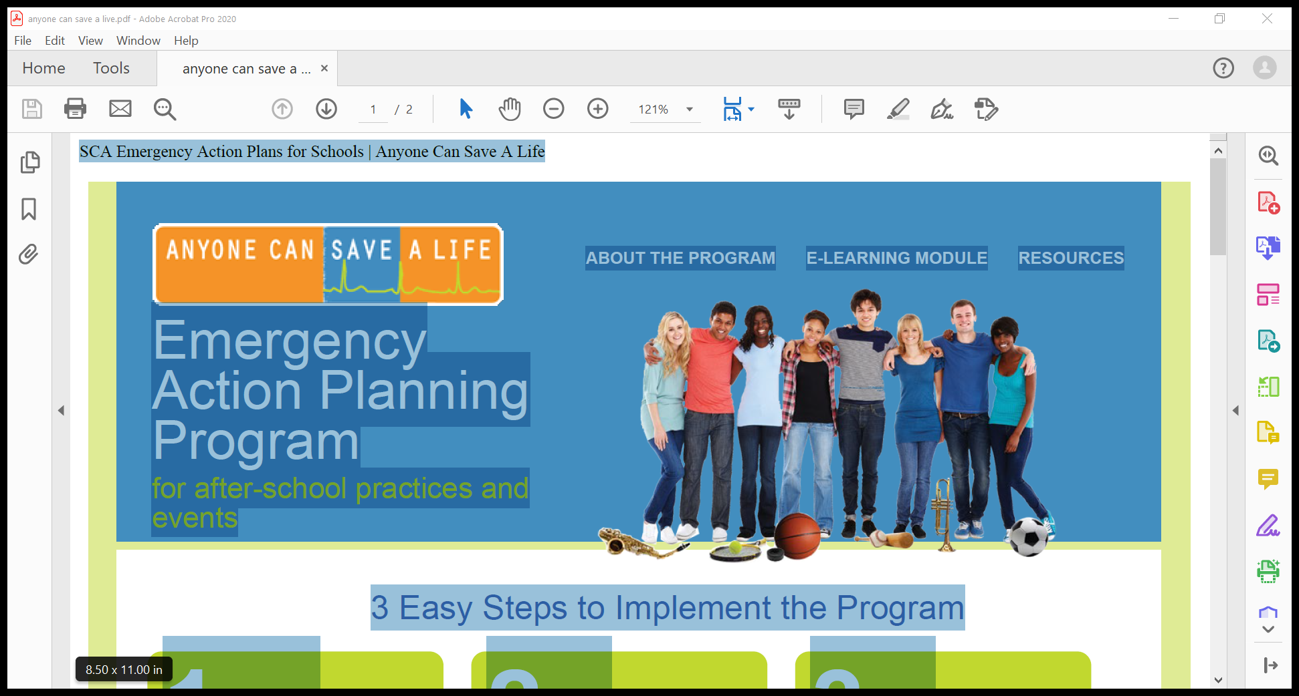

Slide 16
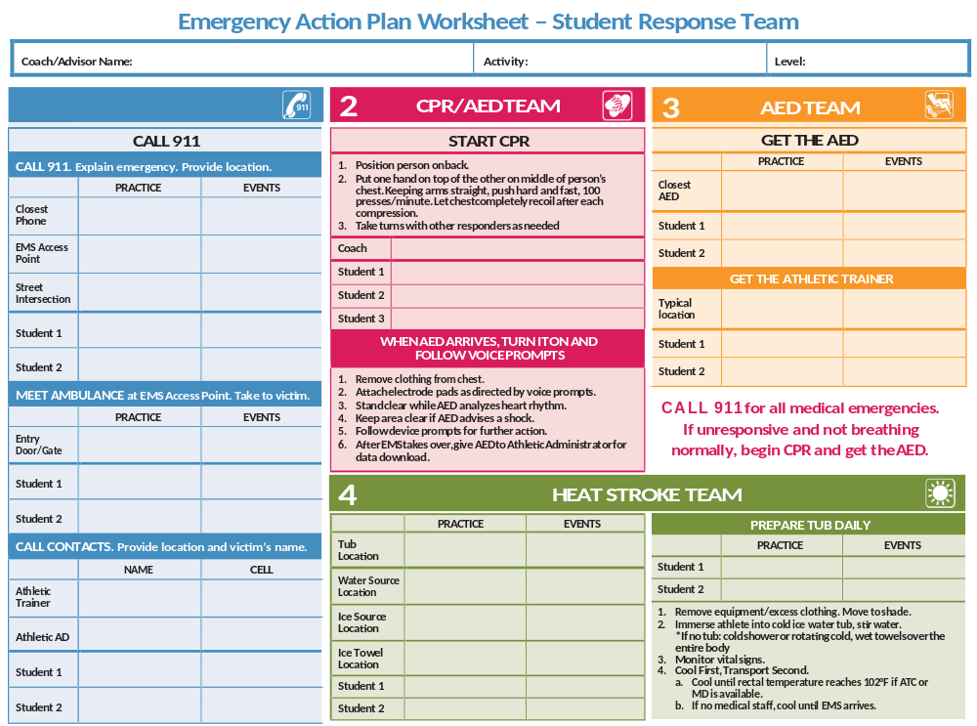

Slide 17
Cardiac emergency

Slide 18
Respiratory
Asthma: who has rescue inhalers, what are the parental instructions for use, where/who keeps inhaler during activity for emergent use
Anaphylaxis: Who is allergic to what, what are the parental instructions, where is epi-pen, where is Benadryl, how much
Choking

Slide 19
Diabetic Emergency
Who is diabetic
Who monitors blood sugar levels and how.
What are the parents instructions for care
Where are the emergency snacks, glucagon, individual supplies

Slide 20
Heat illness
Prevention is paramount
In emergency, how are you cooling while waiting for EMS
Where is the equipment, ice who is responsible for maintaining.

Slide 21
Weather
Thunder or visualization of lightening means an immediate minimum 30 minute hold in shelter.
Where are you putting teams, officials, coaches, spectators
What is your method for communication

Slide 22
Orthopedic
When to move and when to activate EMS
What is hospital of choice, OSHEI, ECMC, local?

Slide 23
Neurological
Any loss of consciousness is treated and neck fracture.
Any loss of consciousness is medical emergency
Stabilize, monitor vitals, activate EMS

Slide 24
